Slide 1


Smart Irrigation Decision Support System Using Simulated Soil Moisture and Weather Data
Java-Based Rule-Driven Irrigation Simulation Project
CSA 0904 – Java Programming
Presented By O. Bhanu prakash Reddy 192372075
M.Mahi reddy 192324082
K.Haneesh 192324084
Sri Hari 192372222
Antony Ajay 192524414
Guided By
Dr. Thalapathy Rajasekaran

Slide 2
Introduction
Efficient irrigation is essential for sustainable agriculture, yet many decisions are still made manually without real-time environmental data.
Smart Irrigation Decision Support System is a Java-based application that simulates soil moisture and weather conditions for demonstration purposes.
The system analyzes simulated environmental data using predefined decision rules to recommend irrigation actions.
No real IoT sensors are used; simulated data is generated to demonstrate the complete decision-making workflow.
The system provides recommendations, alerts, and historical reports to support informed irrigation decisions.

Slide 3
Objective
To design a Java-based decision support system for irrigation management.
To simulate soil moisture, temperature, humidity, and rainfall data for demonstration purposes.
To implement rule-based logic that determines irrigation requirement and water quantity.
To generate real-time recommendations and alerts based on simulated conditions.
To maintain irrigation history and generate summary reports for water usage analysis.
To demonstrate core Java OOP concepts through a practical agricultural use case.

Slide 4
Problem Statement
Imagine a small farmer named Ramesh, who owns a few acres of farmland.
Every morning, he walks through his fields, touches the soil with his hands, looks at the sky, and decides whether his crops need water.
Some days he irrigates more than necessary, wasting valuable water.
On other days, he delays irrigation, causing the crops to experience water stress and reducing their yield.
Ramesh hears about modern IoT-based smart irrigation systems, but the cost of sensors, controllers, and maintenance is far beyond what he can afford.
Like many small farmers, he continues to rely on experience and guesswork instead of data-driven decisions.

Slide 5
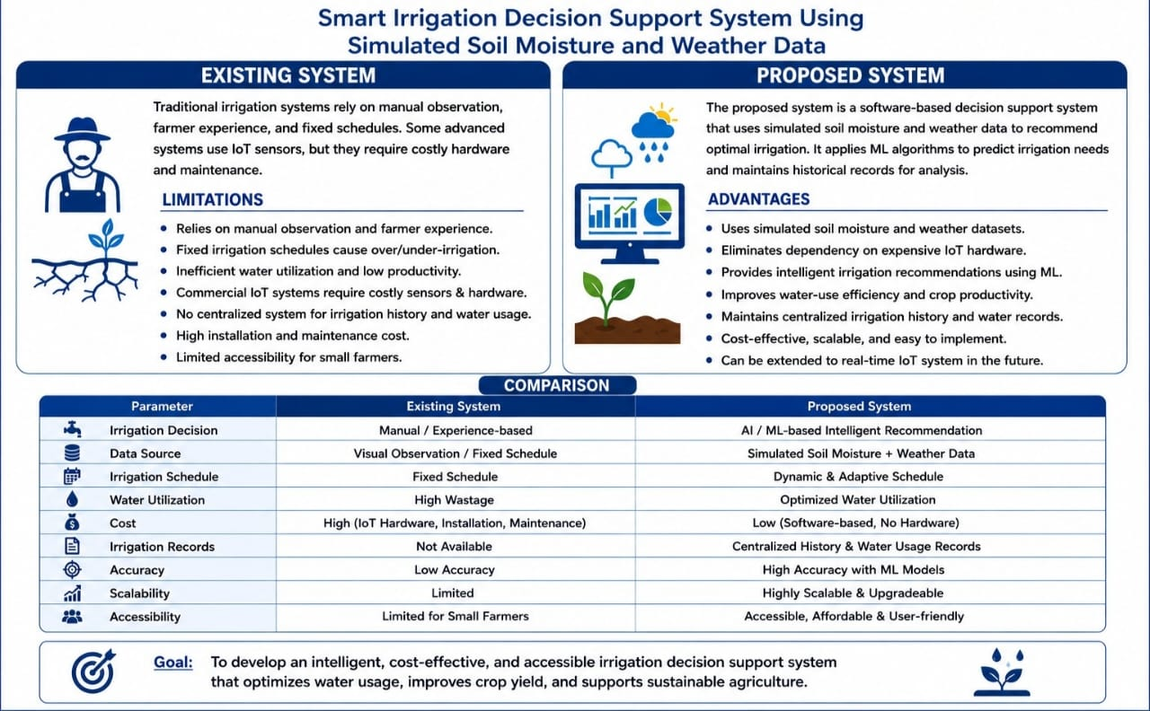
Existing System AND Proposed System

Slide 6
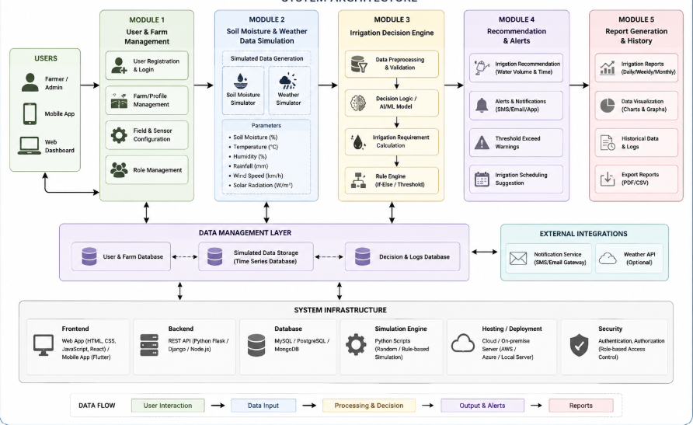
System Architecture

Slide 7
Module 1: User & Farm Management
Allows farmers/users to create accounts.
Provides secure login and authentication.
User registration and login.
Manage farmer profile and farm details.
Add multiple fields/zones with crop information.
Set soil moisture threshold values.
Store farm and crop configuration securely.
Provide personalized irrigation settings.
Stores farmer name, contact details, location, and preferences.
Records crop name, crop growth stage, and approximate water requirement.
Helps the decision engine provide crop-specific recommendations.
Allows users to define minimum and maximum soil moisture thresholds.
Example: If moisture falls below 30%, irrigation may be recommended.

Slide 8
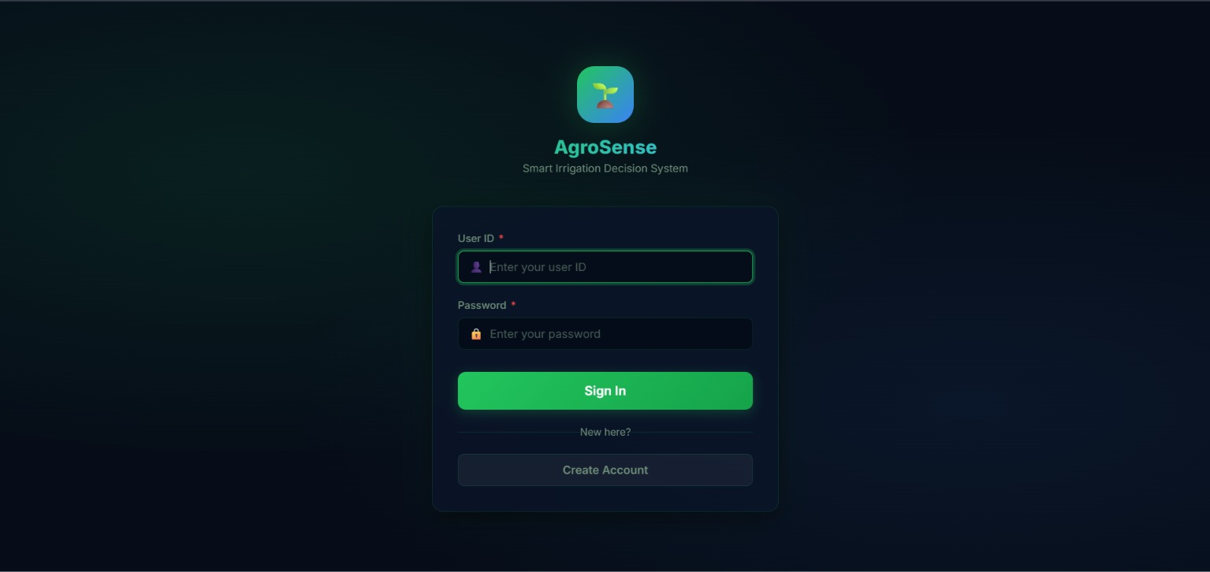

MODULE 1: OUTPUT

Slide 9
Module 2: Soil Moisture & Weather Data Simulation
Simulated Soil Moisture Data:
Soil moisture percentage.
Soil temperature.
Moisture level for individual farm zones.
Dry, normal, and wet soil conditions.
Periodic variation in moisture values.
Simulated Weather Data:
Temperature.
Relative humidity.
Rainfall.
Wind speed.
Solar radiation.
Weather forecast information.
Condition | Soil Moisture | Rainfall | Decision
Dry | Low | No rain | Irrigate
Normal | Medium | No rain | Monitor
Wet | High | Recent rain | No irrigation
Expected Rain | Low/Medium | Rain forecast | Delay irrigation
Extreme Heat | Low | No rain | Increase priority

Slide 10
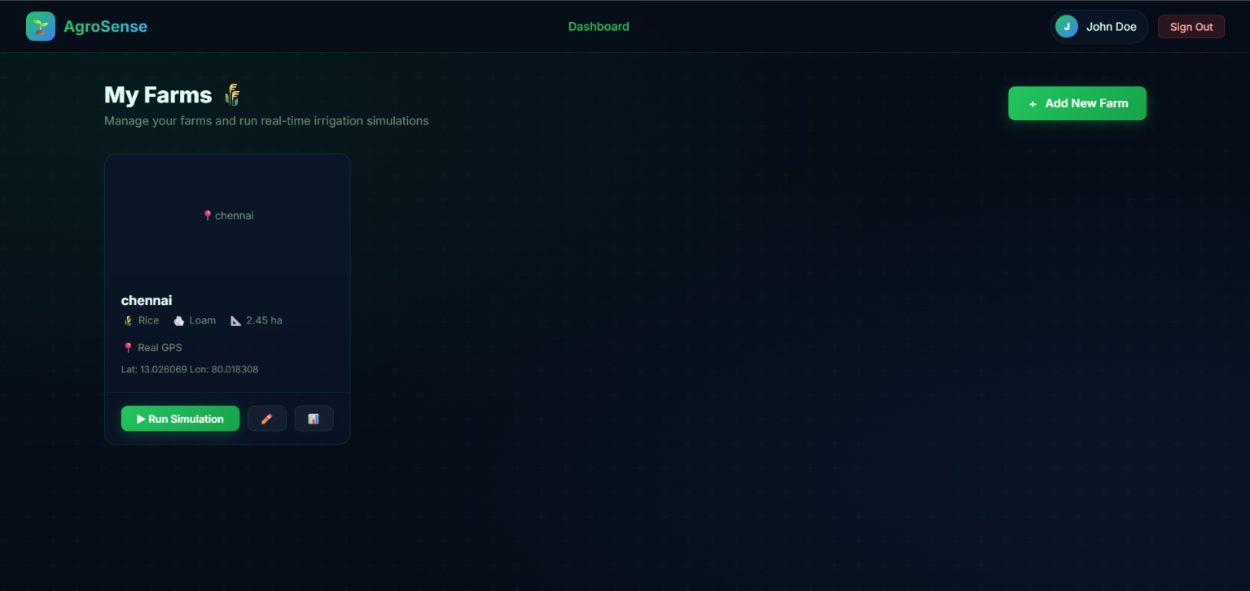
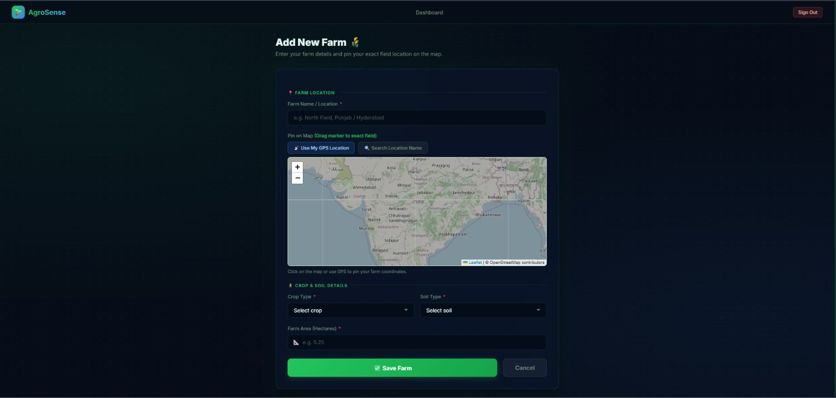
MODULE 2: OUTPUT

Slide 11
Module 3: Irrigation Decision Engine
Advanced Processing:
Calculate water requirement based on moisture deficit.
Estimate irrigation duration.
Consider expected rainfall.
Prioritize zones with critically low moisture.
Prevent unnecessary watering.
Compare current values with historical patterns.
Input Parameters:
Current soil moisture.
Soil temperature.
Air temperature.
Humidity.
Rainfall.
Forecast rainfall.
Crop type.
Crop growth stage.
Soil moisture threshold.
Previous irrigation status.
IF Soil Moisture < Minimum Threshold
AND Rainfall = 0
AND Rain Forecast = Low
THEN
Irrigation = REQUIRED
ELSE
Irrigation = NOT REQUIRED

Slide 12
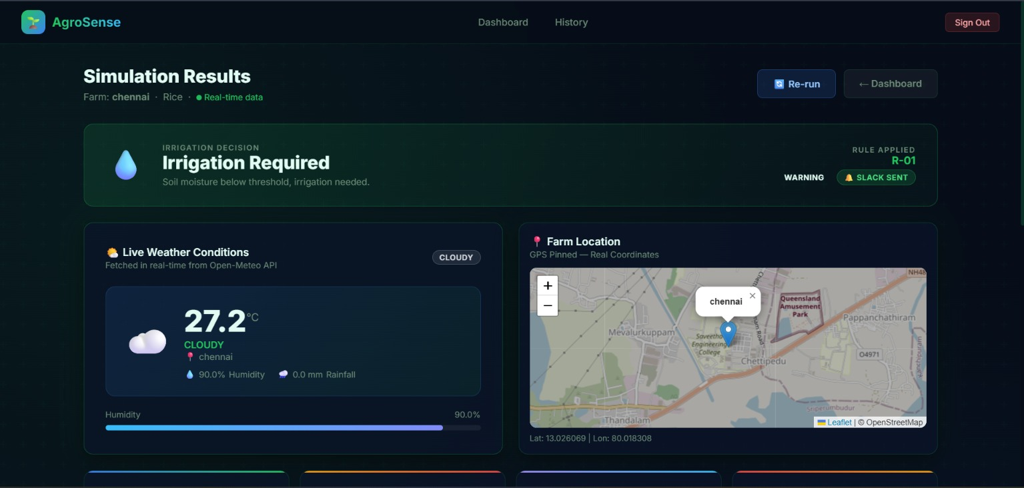
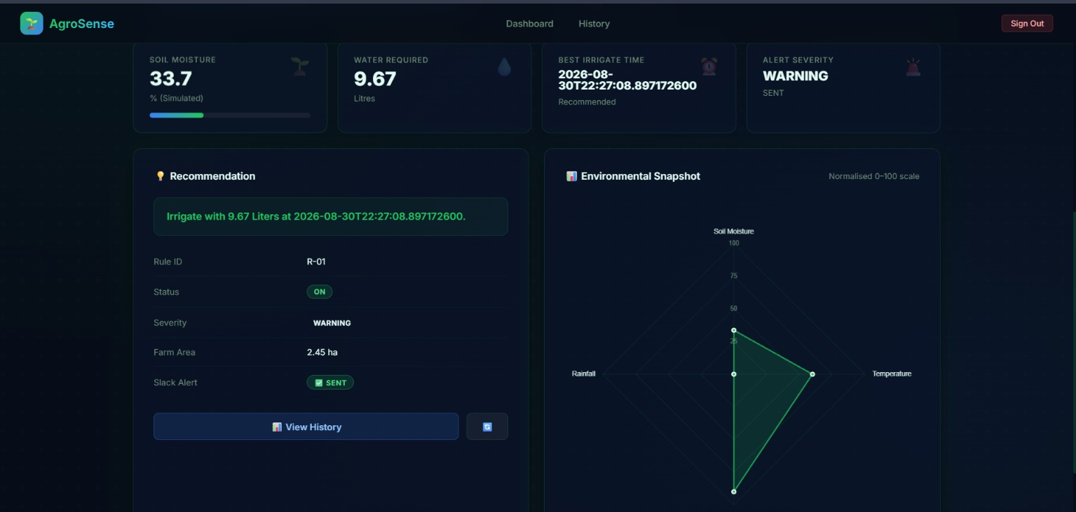
MODULE 3: OUTPUT

Slide 13
Module 4: Recommendation & Alerts
Irrigation Recommendations:
Displays whether irrigation is required.
Provides zone-wise recommendations.
Suggests irrigation duration.
Provides preferred irrigation time.
Indicates urgency of irrigation.
Alerts:
Low soil moisture alert.
Very low/critical moisture alert.
Heavy rainfall warning.
Irrigation delay notification.
Abnormal sensor-data alert.
Extreme temperature warning.
System/data communication failure alert.
Example:
Zone 2: Soil moisture = 24% Status: Critical Recommendation: Irrigate Suggested Duration: 20 minutes Reason: Low soil moisture and no significant rainfall expected.

Slide 14
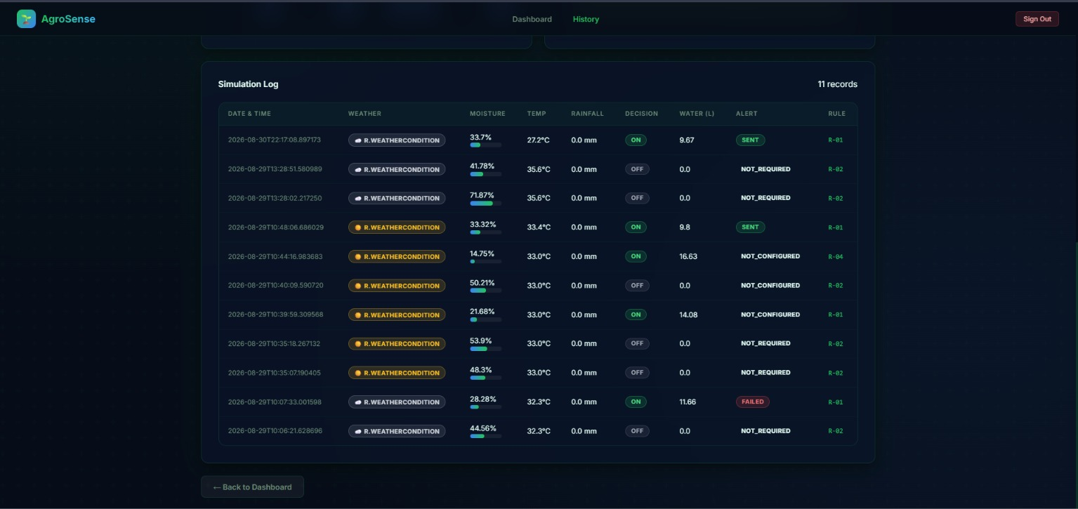
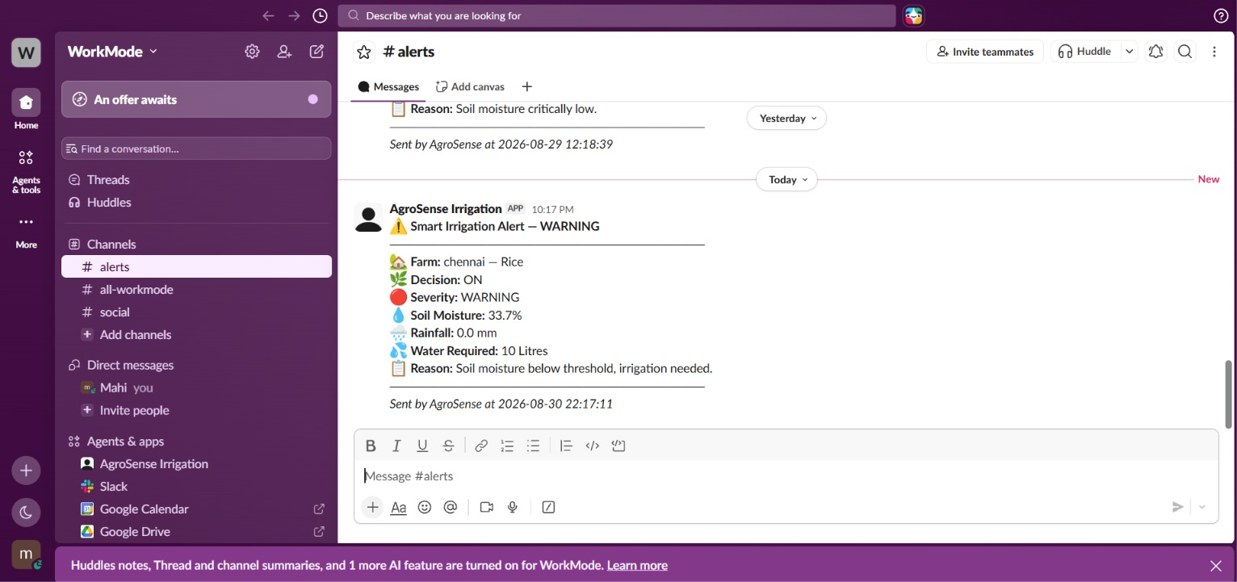
MODULE 4: OUTPUT

Slide 15
Module 5: Report Generation & History
Reports:
Daily irrigation report
Weekly irrigation report
Monthly irrigation report
Soil moisture trend report
Weather trend report
Zone-wise irrigation report
Water requirement report
Irrigation efficiency report
Store soil moisture, weather, and irrigation records.
Maintain historical irrigation decisions.
Generate daily, weekly, and monthly reports.
Show moisture and weather trends using graphs.
Compare irrigation requirements across farm zones.
Support analysis of water usage and irrigation efficiency.

Slide 16
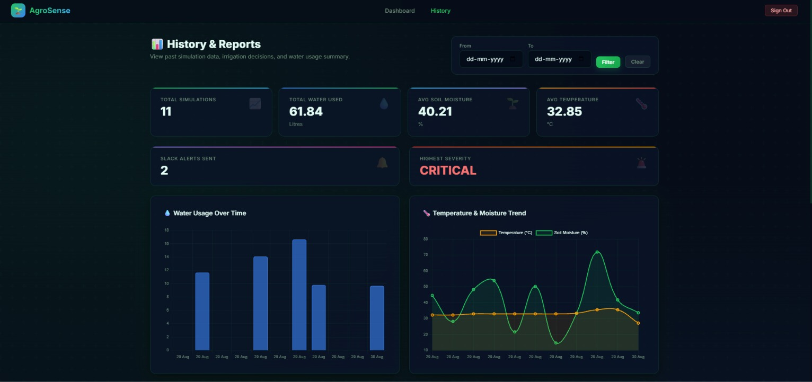
MODULE 5: OUTPUT

Slide 17
System Flow
1. User
Registration
2. Farm
Details
3. Generate Simulated
Soil & Weather Data
4. Analyze
Data
8. Generate
Reports
7. Save
History
6. Recommendation
& Alerts
5. Irrigation
Decision Engine

Slide 18
Conclusion
The Smart Irrigation Decision Support System demonstrates how Java can be used to build a rule-based agricultural decision-making tool.
Simulated soil moisture and weather data enable a safe, hardware-free demonstration of irrigation logic.
The system combines data simulation, decision-making, recommendations, and reporting into a single cohesive application.
It serves as a strong foundation for future integration with real sensors and machine learning models.

Slide 19


